Slide 1
Post Acquistion Pipeline

Slide 3
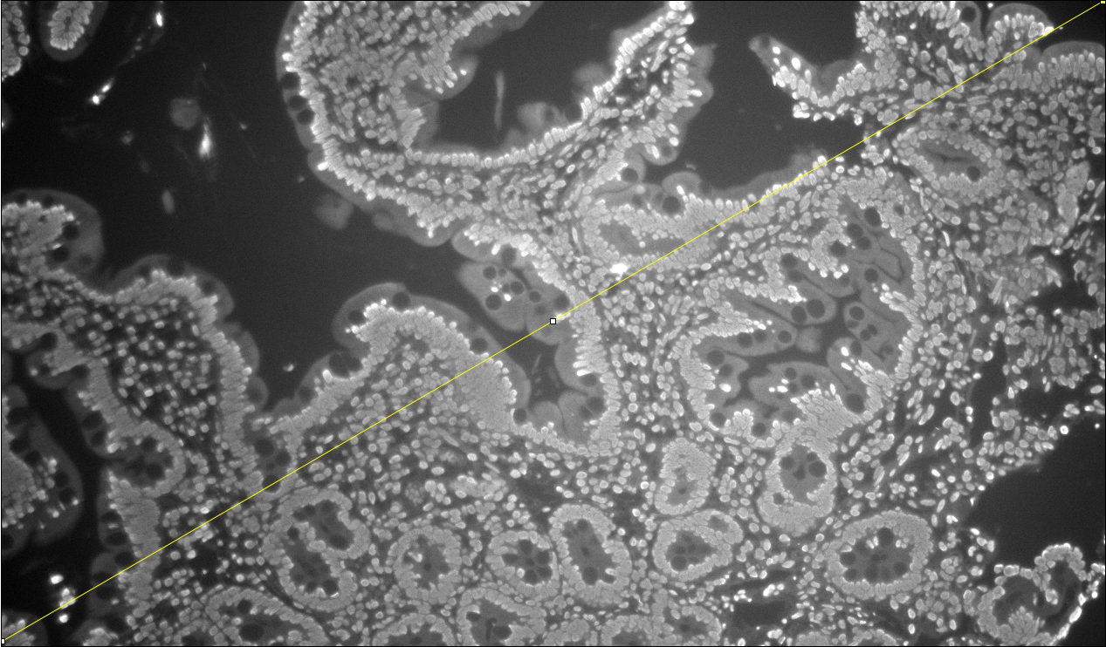
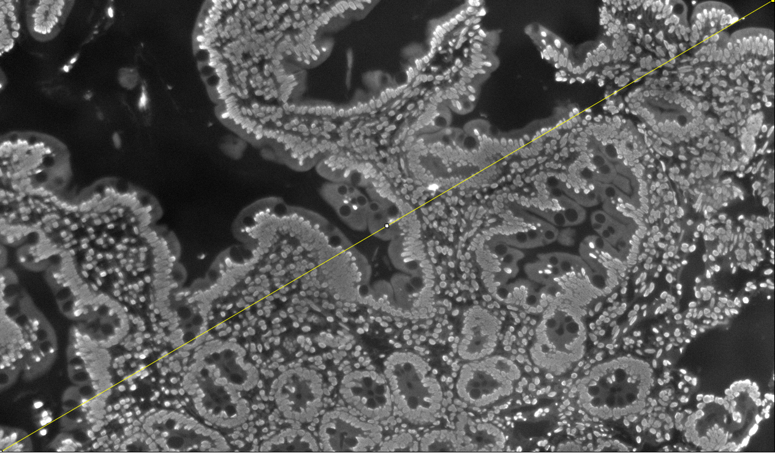
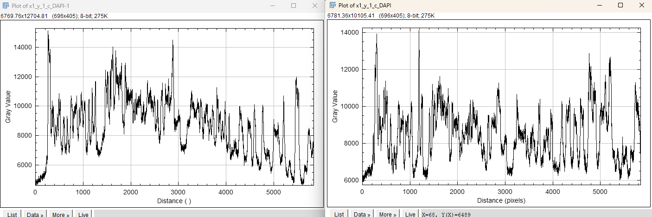
BaSiC Demo
Raw
Basic Estimator Applied

